Slide 1


Introduction to our service level offering
This Photo by Unknown Author is licensed under CC BY-SA

Slide 2

Aile Aviation Services
Why should you consider ?

Slide 3
Considerations I
Control over 1,735,073 Parts
  Controlled in 5 global warehouses out of the 961
Over 217 Article groups
From 961 Warehouses globally
2,201 sourcing partners
2,998 clients globally
4,657 quotes brought out in 2017

Slide 4
Considerations II
Established industry contacts and relationships
  Boeing, Airbus, Fokker, BAE etc. up to 4,424 contacts
Baseline turn over established
Statistic Cost control available
In the market as from 1993
Global operations
Standing Organization
Highly appreciated Logistical service

Slide 5
Considerations III
On stop shopping service offering
legally sound industry contracts in place
  MOU’s, LOI’s, Sales Contracts, Exchange contract’s, NCND’s, Terms of delivery, Terms of purchase and many other…
For more detailed information on our Service offerings please check presentation “Introduction to Flight”

Slide 6
Some performance data
Considering global coverage
  On time delivery 91,4 %
    Based on Clients expectation
  Of the On time delivery almost 50 % where Early delivery
    Beyond Clients expectation
  Late delivery 8,6 %
    Late payment by Customers, & parts held until payment received, accounts for approx. 87,5% of all late deliveries

Slide 7
Systems & Resources
We have the IT environments in place
We have the systems in place
We entertain a extensive quality manual that was approved year after year
We have NATO NCage code: H2HG8
We have the procedures in place
We have the work instruction in place

Slide 8
Quality objectives
Since quality is the justification of our existence and continuity is our primer objective we will not settle for less.
Periodical employee’s quality objectives both on personal, group and general level reviews are addressed in the employee’s periodical personal assessment and updated by the periodical Quality training and up date meetings.
Review of quality objectives as per function for all personnel Periodical reviews are addressed in both the employee’s periodical personal assessment and warranted by the periodical Quality training and up date meetings.
Quality objectives are held for each function electronically in the form of the company’s quality objectives handbook, which is available to all staff.

Slide 9
Quality Objectives as per:
ISO 9001:2015 International Quality System Standard
AS 9120B: 2016 Industry Quality System Standard
AQAP 2310B issue 1 NATO Quality Assurance Standard
Incorporating
ASA 100 & ATA 300 industry standards
FAA AC 00-56A & AC21-29D

Slide 10
Supplier performance
Supplier’s performance is important to enable Aile Aviation, on its turn, to achieve her performance toward the customers.
A front door policy is maintained by means of experience based criteria, where we inspect requests and or offerings from various sources.
Where product / service Availability is a major driver (KPI*), and Product Quality is always as per customer agreement, prior to any PO** action being taken.
Suppliers are reviewed on a performance basis on a project by project basis.
We periodically send out a supplier’s survey in order to establish most current certification and capabilities. These are kept on record.
* Key Performance Indicator ** Purchase Order

Slide 11
From the 2017 QMS Management report
Customer satisfaction
  Aile Aviation as a service provider is dependable of its customer’s satisfaction and therefore these aspects are of the greatest importance in respect to the continuity of our company.
  We pride ourselves receipting spontaneous customer satisfaction endorsements and find them, rewarding, motivating and stimulating.
  Customer complaints to date are recorded on and in respect to the all transactions represent a complaint rate of 0 %.

Slide 12

QMS Requirements Model of process based quality management system

Slide 13
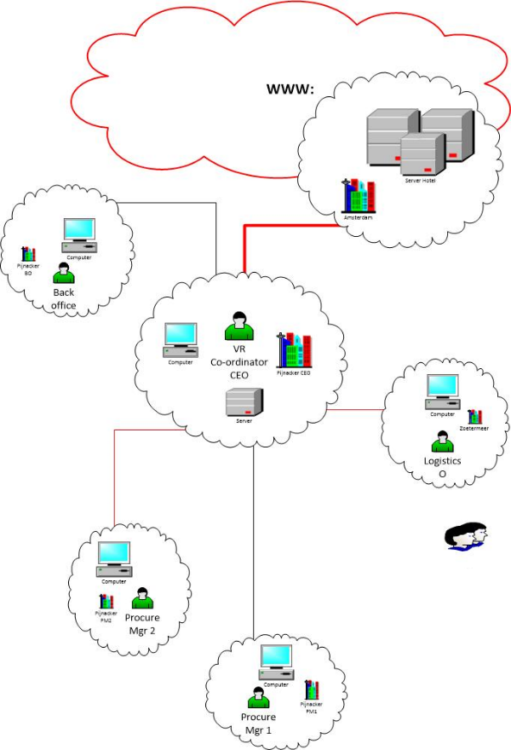
The technical infrastructure

Slide 14
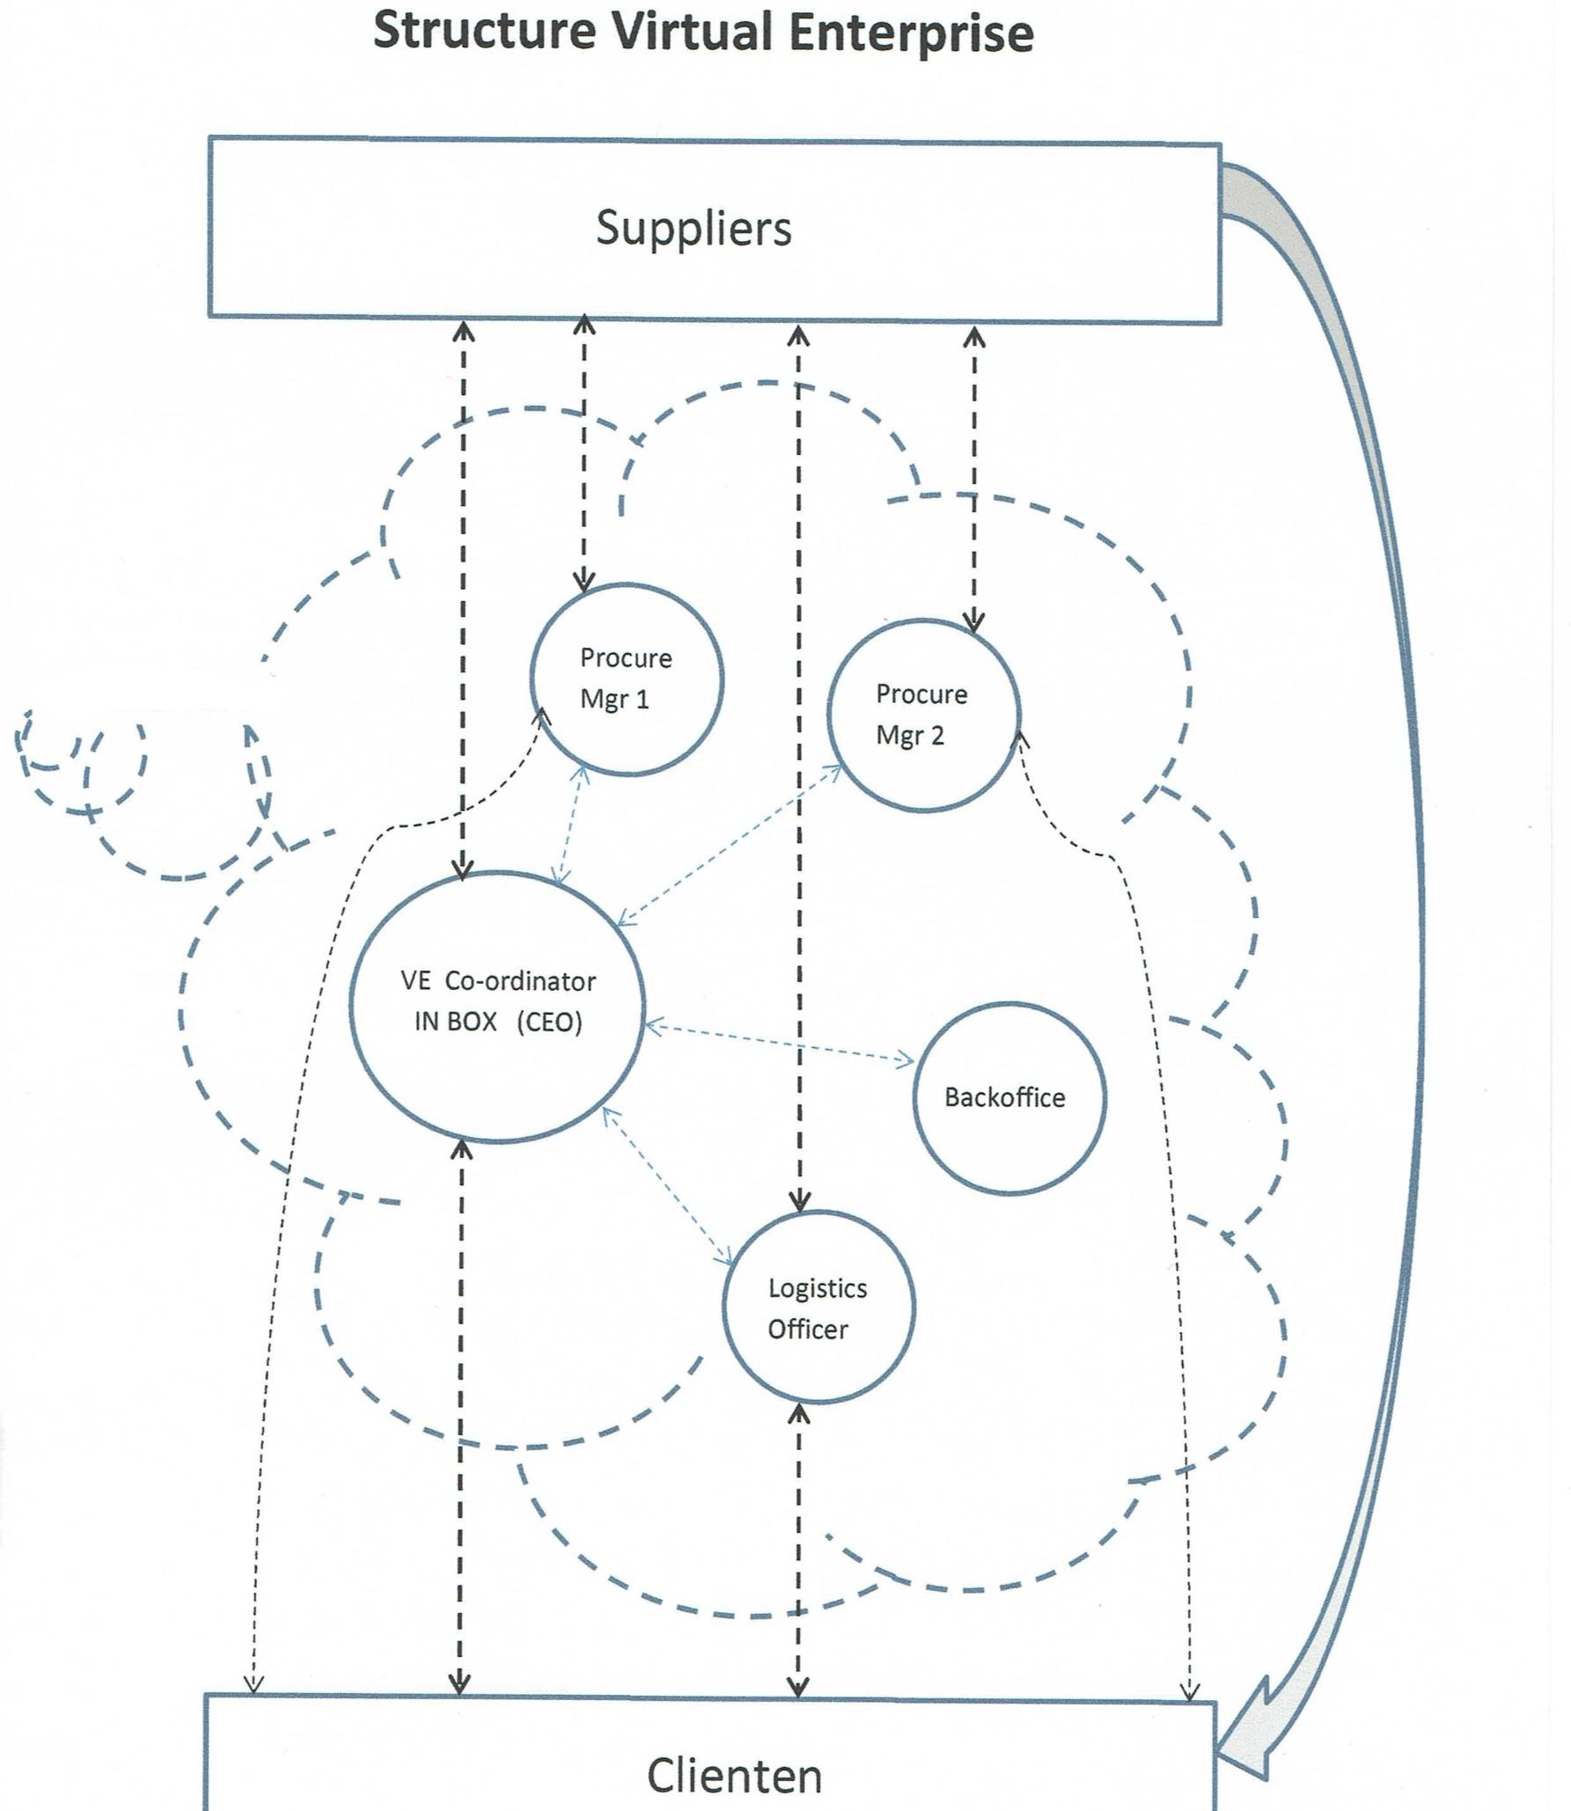
The logical infrastructure

Slide 15
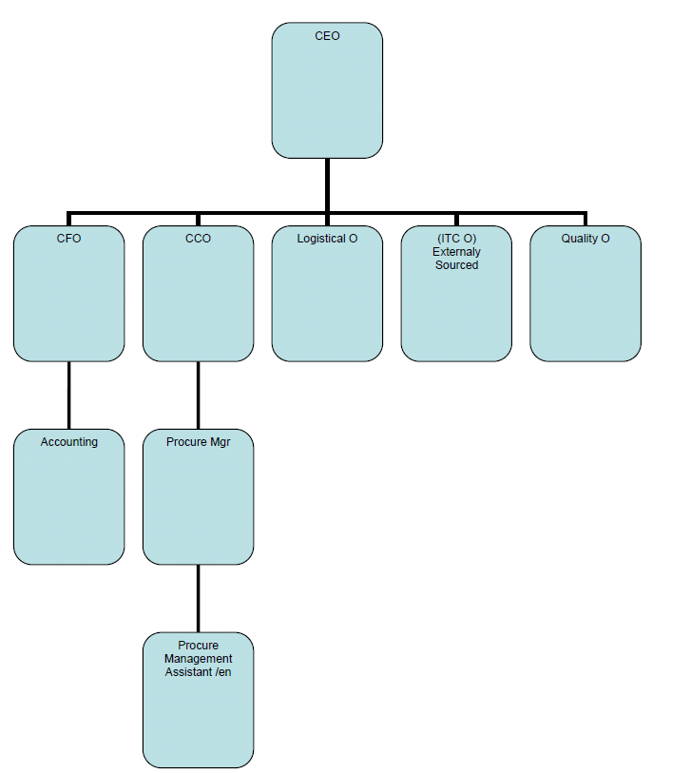
Organogram

Slide 16
Question is; Are you ready ?
We Are !

Slide 17


You are welcome to the family

Slide 18


Introductie to Flight
Isn’t it all about
Un-disturb operation's

Slide 19
The Shape of service
S.L.A.
Exchange Management
M.E.L. Pool Management
Structured Periodical Supply Management
Un-structured Incidental Supply

Slide 20
The most comprehensive level of service
S.L.A.
Exchange Management
M.E.L. Pool Management
Structured Periodical Supply Management
Unstructured Incidental Supply
Service Level Agreements
The top of the service model combines all service aspects where expectations towards the services provided are auditable and pre-set to the demand of the contract parties.
M.E.L. Pool Management
Our Minimum Equipment List Pool management program offers back up and exchange capabilities to assure your undisturbed delivery to keep operations at the demanded levels.
Structured periodical Supply Management
Your annual/periodical requirements can economically be offered in to our structured distribution plan. A example of material that suites the program are expendables, lamps, bolts, tires etc.
Exchange management
High investment material will most of the time take less investment once the Aile Aviation exchange program is utilized
Unstructured incidental Supply Management
A primary distinction is made amongst the services Aile Aviation can provide. The most common service is where Aile Aviation helps you on all or any of your unstructured Ad Hoc requests and demands.
Service Level Agreements
M.E.L. Pool Management
Structured periodical Supply Management
Exchange management
Unstructured incidental Supply Management
Warranty Claim Management

Slide 21

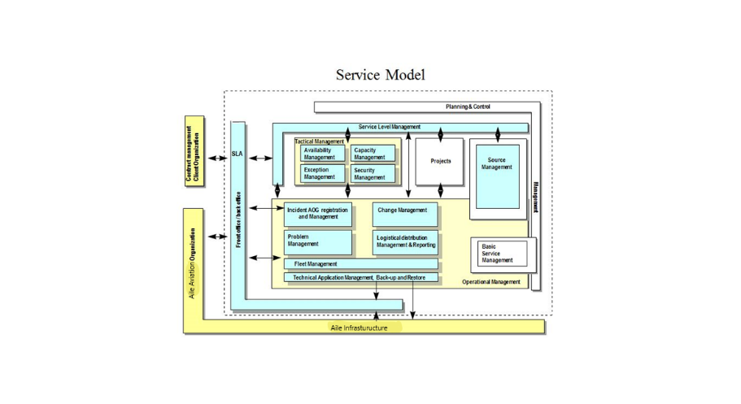
Service in Shape
S.L.A.
Exchange Management
M.E.L. Pool Management
Structured Periodical Supply Management
Unstructured Incidental Supply

Slide 22

Process |  | Description | Service Level |  |  | Reporting
# | Type |  | Bronze | Silver | Gold | Y/N | Criteria
Service Level Management
SLM-01 | Service | Evaluation of quality of service (service level return) | annual | per 6 months | per 3 months
SLM-02 | Reporting | Service level reporting | non | per 6 months | per 3 months
SLM-03 | Service | Furnishing period of new service level demand | Standard 2 months | Standard 3 months | Standard 4 months
Front Office / Back office
HDE-01 | Service | Front / back Office availability hours | Standard 9,5 * 5 * 365 | Standard 9,5 * 6 * 365 | Standard 7 * 24 * 365
HDE-02 | Service | Request registration, estimation, management, follow-up and coordination. | Business days 07:30 to 17:00 GMT +1 hrs. | Business days 07:30 to 17:00 GMT +1 hrs. | Business days 07:30 to 17:00 GMT +1 hrs.
HDE-03 | Service | Incident registration, estimation, management, follow-up and coordination. | Daily, weekly and monthly | During Service hours | During Service hours
HDE-04 | Reporting | Periodic reporting in respect to requests and Incidents | not applicable | per 3 months | each month
Chrystal clear contract model
Choice is up to you: Bronze-, Silver- or even the Gold level.
Our service will follow your business model and will apply to your total fleet, an individual aircraft or even for a specific group of parts.

Slide 23
What will our SLA’s bring you?
Clear inside on your Total Cost of Ownership
Cost reduction
It’s there when you need it
Predictable cost
brings peace of mind
Reducing
work
load

Slide 24
E-mail Info@aileaviation.com
Web-site www.aileaviation.com
Pijnacker,
The Netherlands.

